Slide 1
Deep Learning Architecture: Neural Image Caption Part 2
_____________________________________________________
Khrystyna Semkiv, Priya Shukla, Raghu Shantharam
Communication and Information Technologies

Slide 2
Further improvements
Use our own pictures (for training or evaluation);
Since we use smaller dataset we can change hyperparameters and try different regularization techniques such as augmentation;
Convert the text description into speech;
Human Evaluation can be done with more people (7-10);
Borrow approach of LSTM part from another papers;
Novel descriptions can be added into vocabulary of reference sentences;
Check how the model works using unsupervised data;

Slide 3
Dataset

Slide 4
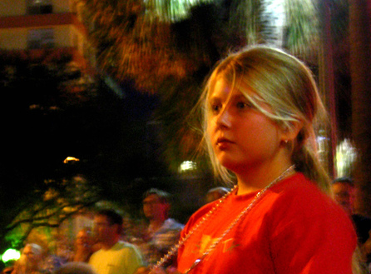
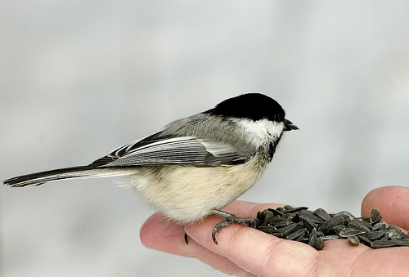
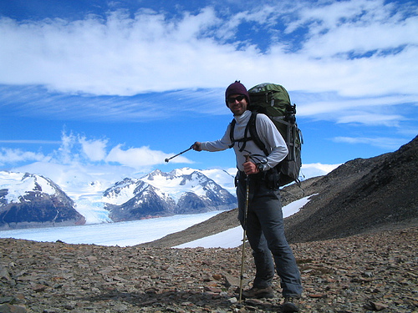
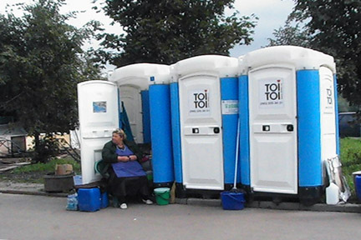
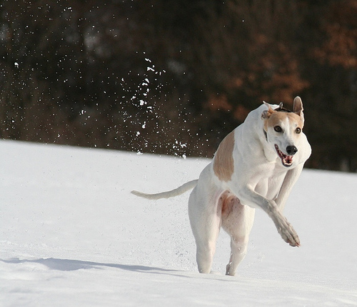
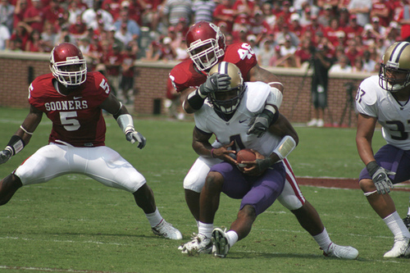
Flickr8k dataset
Dataset contains 8000 images, each of which is paired with 5 different captions
Images depict variety of scenes and situations
Advantages:
It is small in size (the model can be trained easily on low-end laptops/desktops)
Data is properly labelled
The dataset is available for free

Slide 5
Algorithm

Slide 6
Pre-processing
Image
Fixed size of the images
Removing images that has too long (25) or too short (5) caption length
Additional techniques: random flip, random rotation, random contrast
Text
Add <start> and <end> tokens to each caption
Replace uppercase strings with lowercase
Remove some strip chars ("<", ">")
*It is resulted in reducing the dataset size 7643 (train 6114, test 1529)

Slide 7
Encoder
Base model for classification
Number of layers (MultiHeadAttention)
Types of layers
Normalization techniques
Initialization
Dropout

Slide 8
Decoder
Number of layers (MultiHeadAttention, Dense layers)
Types of layers
Dropout (inside layers, between layers)
Normalization techniques
Initialization

Slide 9
Training
Loss function: categorical crossentropy
Optimizer: Adam
Number of epochs: 30
Adaptive learning rate
Early stopping

Slide 10
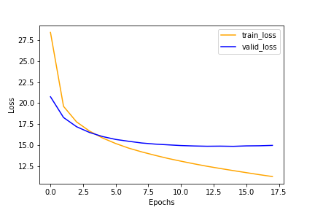
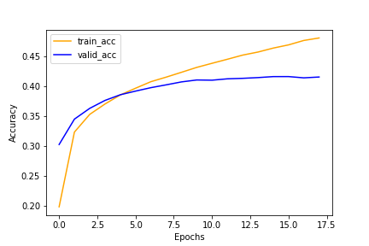
Output rates

Slide 11
Experiment
Size of the dataset
Updating preprocessing part
Changing descriptions to the vocabulary
Adding dropout to the encoder
Changing dropout in the decoder
Changing the number of epochs (also affects the learning rate)
Removing early stopping
Changing the optimizer
Changing the batch size
Adding layer + normalization layer to the encoder
Adding layer + normalization layer to the decoder
Changing the base model for classification task

Slide 12
Text-to-speech

Slide 13
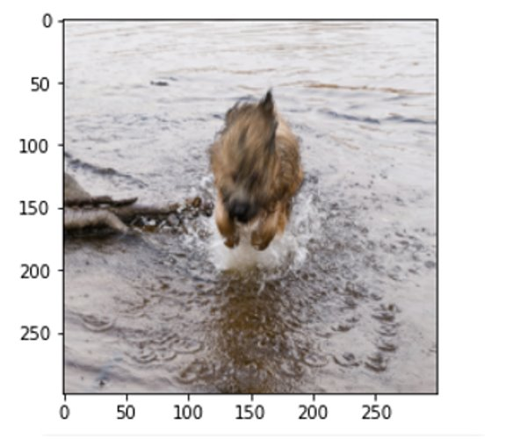

Used libraries:
gTTS a Python library to interface with Google Translate's text to speech API;
Audio/playsound to play the record;

Slide 14
BLEU SCORE

Slide 15
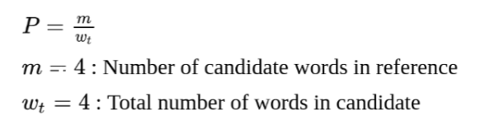
BLEU
Used libraries:
The sentence_bleu() from nltk library provides the evaluation of the generated (candidate) sentence with reference sentences
*Reference and candidate sentences are provided to this function as tokens
BLUE-4 is used here

Slide 16
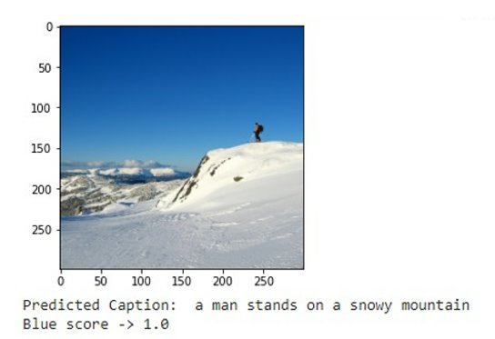
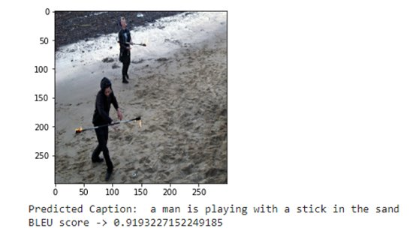
BLEU Results

Slide 17
Human Evaluation

Slide 18


Human evaluation
Approach
Estimation folder consist of 7 pictures that were taken from our galleries;
8 people were evaluating every generated caption from 1 to 4;
To remove the bias every person who did evaluation wasn't informed about the algorithms changes;
Final value is taken as a mean;
Personal
Images

Slide 19
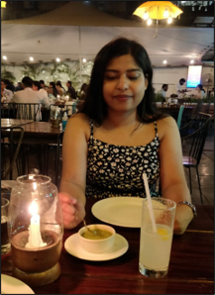
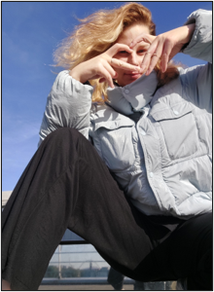
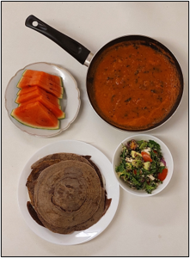
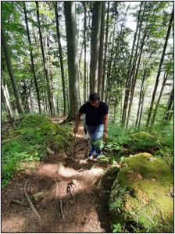
A woman in a black dress is standing in front of a restaurant
A woman in a white shirt is standing next to a large rock
A woman in a blue jacket and a hat sits on a bench
A boy in a blue shirt is sitting on a dirt path

Slide 20
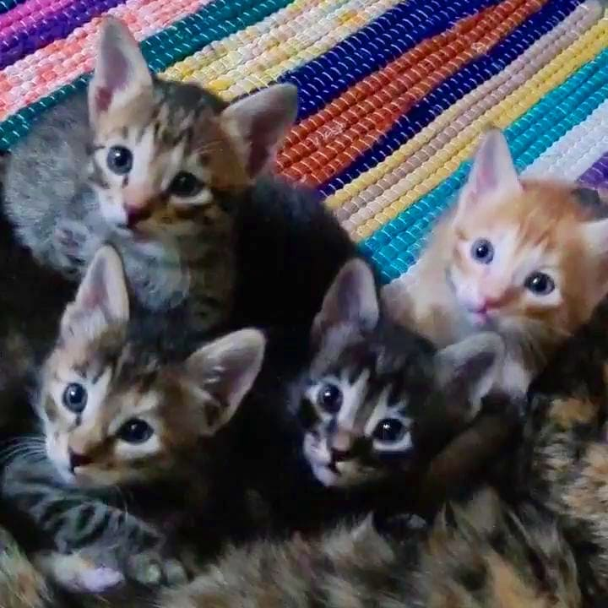
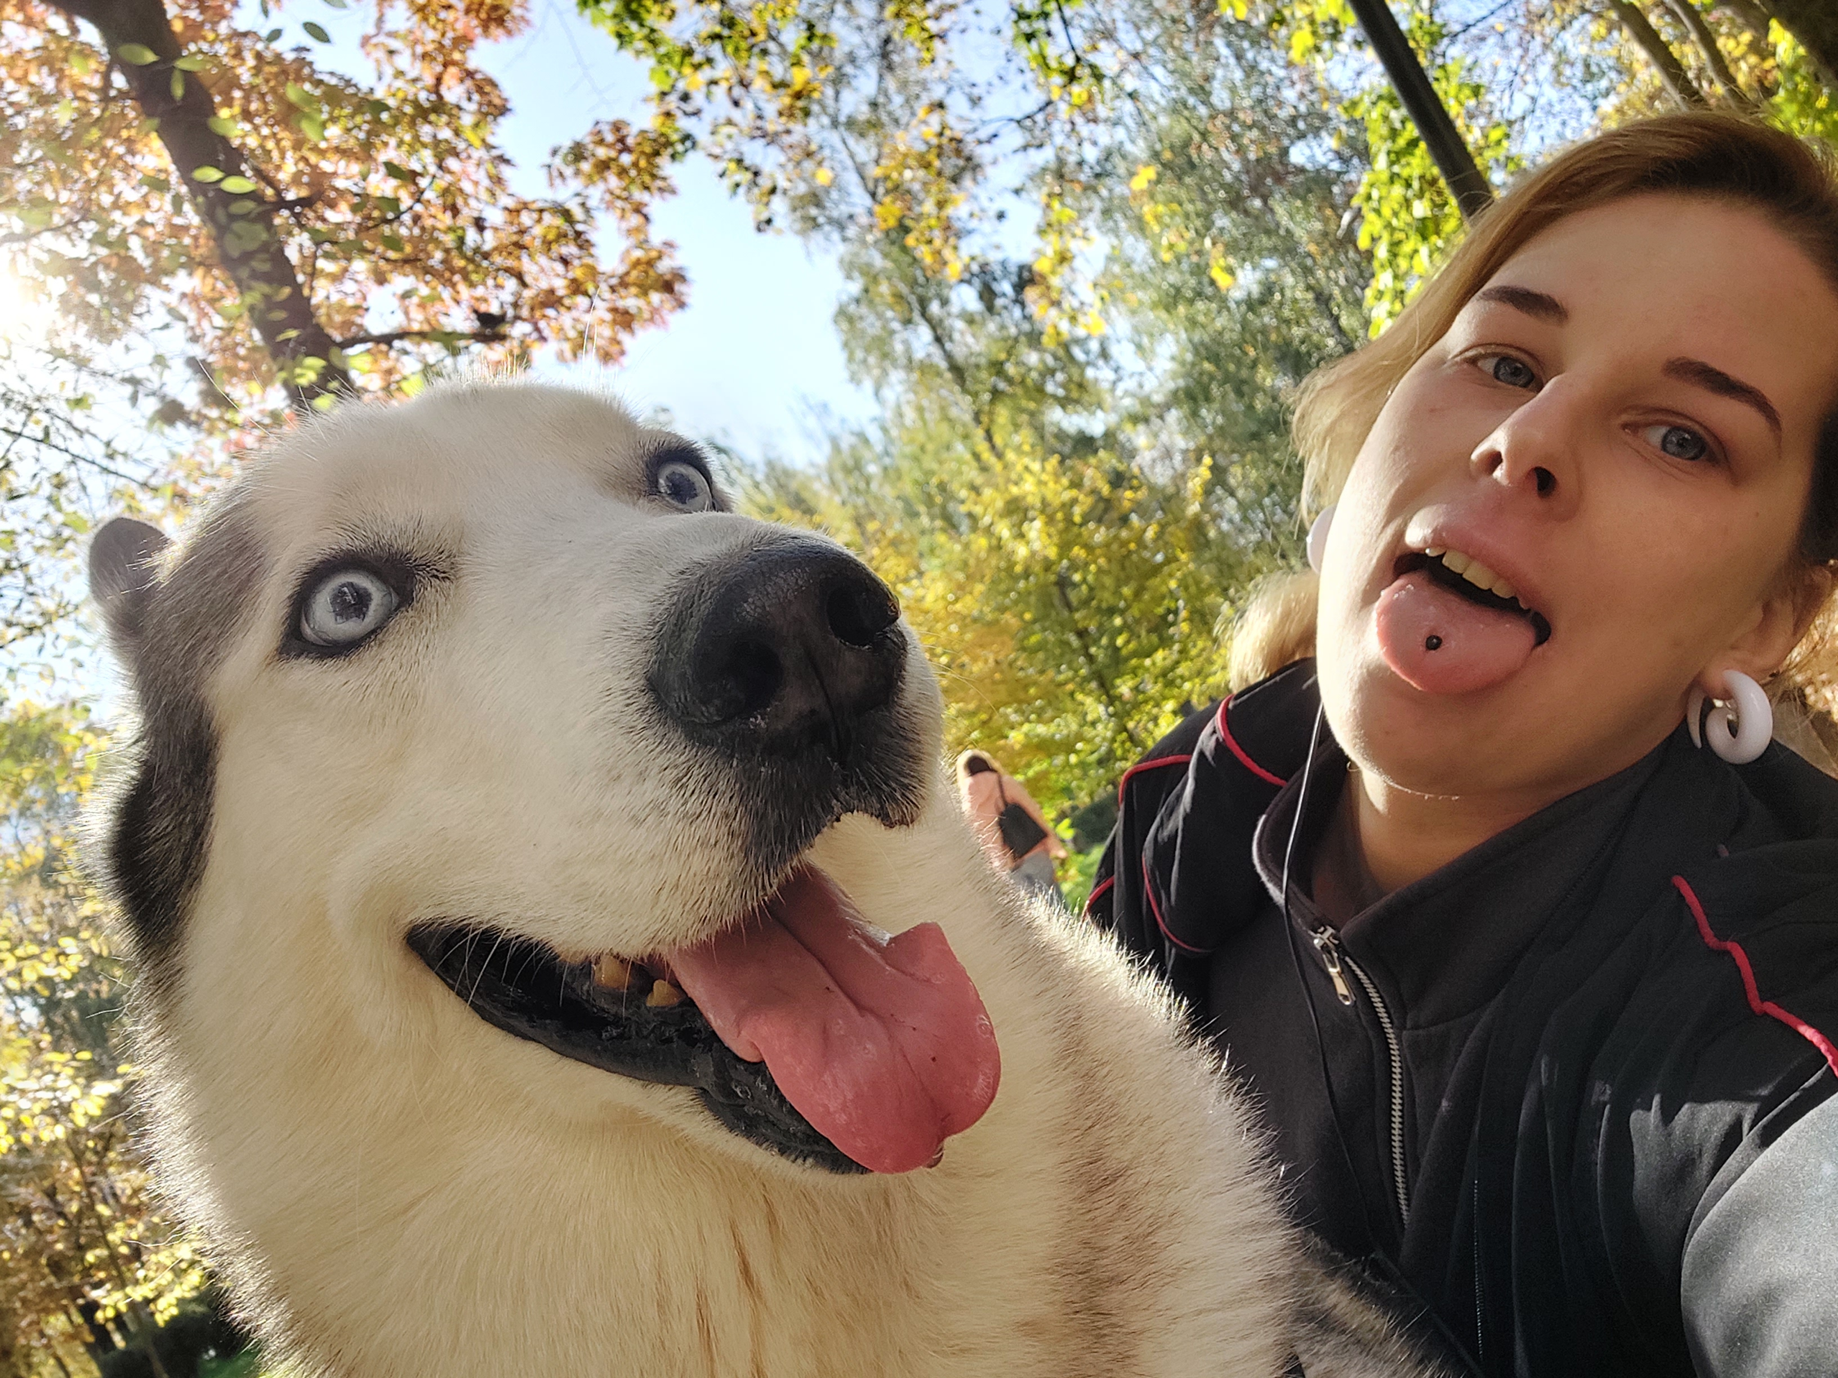
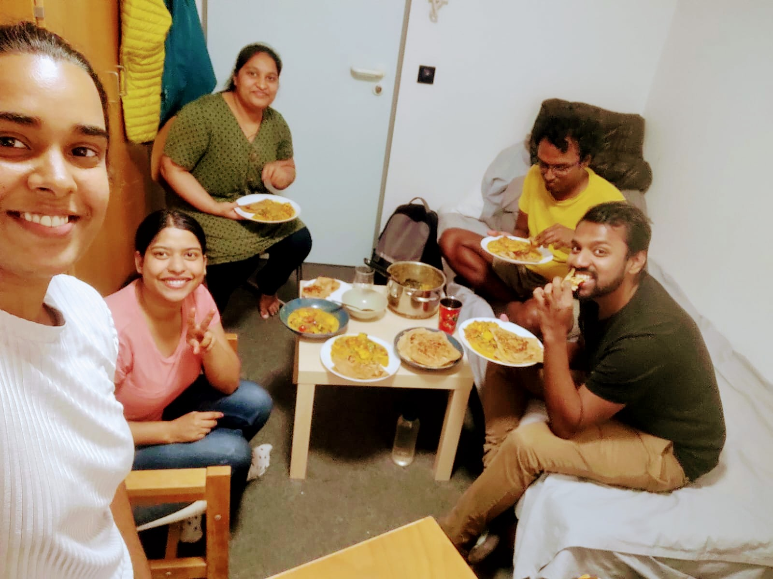
A small dog is jumping on a bed
A young girl in a black jacket and white dog with a red collar
A group of people are sitting on a couch and holding a baby

Slide 21
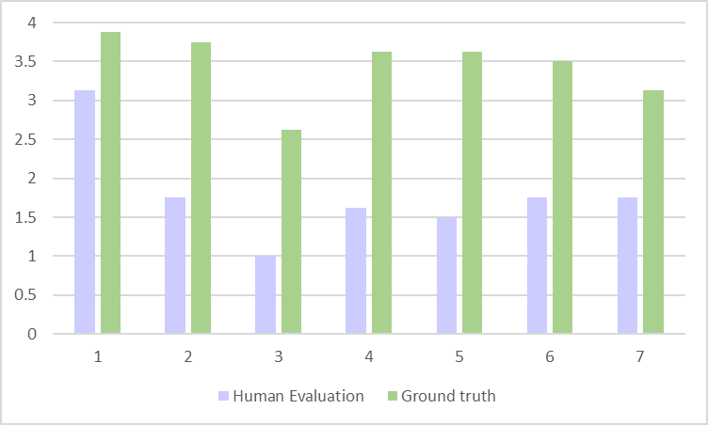
Human evaluation results​
score
images

Slide 22
Conclusion
What have we modified/added?
BLEU score implementation to provide additional objective assessment of the results;
Text-to-Speech;
More people for the human evaluation to improve the accuracy of result;
Algorithm assessment
Poor performance;
Algorithm should be done on big data so it is updated with new updates and it learns from everywhere and has different kinds of images;
To improve existing model we have highlighted the sensitive parts of the algorithms;
A powerful device is needed to handle such complicate machine learning methods;
We can't compare our experiment to the original paper;
At this level it can be fun to process own pictures, but not to use it as an already prepared tool;
Additional observations
A few classes of detected objects;
Not really understandable why the authors of the code set such limitations to the sentence length (5-25 words);

Slide 23
Our opinion about paper and idea
Paper is structured well and easy to read with equations, pictures, references and tables
Performed on different datasets
Different evaluation methods for the results
Idea is innovative and it would help the visually impaired people if the description is more accurate
No proper motivation specified in the paper
Not many further improvements mentioned in the paper other than unsupervised learning
There is no access to their code

Slide 24

Questions

